Slide 1
VISUAL LITERACY
READING THE VISUAL

Slide 2
WHAT IS VISUAL LITERACY?
Visual literacy is a term used to describe being able to read texts that are not just words. Reading pictures is a type of reading that is very important. Pictures communicate meaning to a responder. They “speak” to us and ask us to respond.

Slide 3
WHY IS VISUAL LITERACY SO IMPORTANT IN OUR SOCIETY?
Many of the forms of communication and texts in our society are visual. We are surrounded by pictures every day. Each day we see advertisements, films, TV shows, posters, photographs, painting, drawings and the internet.

Slide 4
HOW DO WE COMMUNICATE?
Communication is what happens when two people interact. Communication is a two-way street. We might say something to another person, but they respond to and interpret what has been said. We can communicate in many different forms. We speak, we write, we draw, we photograph, etc. What is the meaning of the following object in Western culture?

Slide 6
MEANING OF THE HEART
We share the idea that this is a heart despite not looking like an actual heart.
We share the idea that it means love despite the fact that hearts do not feel emotion.
The colour also signifies passion and love.
What do you think the following slide means?

Slide 7
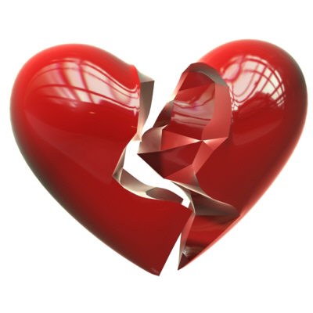

Slide 8
READING STILL IMAGES
There are various elements to look for in a still image that will help you understand how it creates meaning. These include Colour, Line, Vectors and The Reading Path, Viewing Angles and Perspective, Background, Foreground, Contrasts, Texture, Salience, Offers and Demands, Modality and Frame.

Slide 9
COLOUR
Colour has meaning within cultures. The meaning is not fixed, but generally we can give colours a meaning.
Write down the meaning of the following colours.

Slide 14
MEANING OF COLOURS
Red = Passion, Hot, Love, Anger
Blue = Sadness, Cold, Winter, Calm
Black = Evil, Nothing, Darkness
Green = Nature, jealousy, Spring

Slide 15
LINES
Lines also have meaning within our culture.
For Instance:

Slide 16
Horizontal: Calm, Horizon, Lack of difficulty

Slide 17
Curved: Less predictable, water, fluid, movement, natural

Slide 18
Vertical: Isolation, lack of movement, trees, people

Slide 19
Jagged: Danger, Destruction, Anger

Slide 20
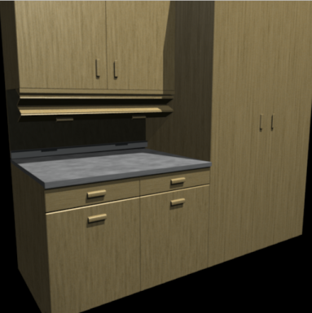
Right Angles: Artificial, Man made, cold, harsh

Slide 21
VECTORS
Vectors are how the eye is led through the picture. This also relates to The Reading Path. In Western society, we are taught to read from left to right. This means we usually look at a picture from left to right. We also read from top to bottom. A vector will influence the order in which we look at the elements of the picture.

Slide 22
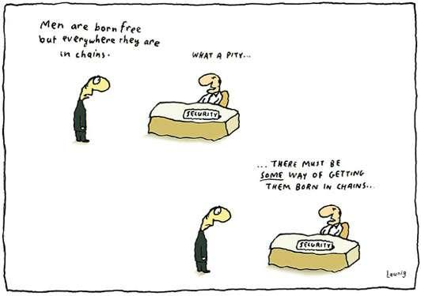
Think about how we read this cartoon

Slide 23
VIEWING ANGLES
Viewing angles are the angles from which we view a picture. This works the same way as it does in film. We may be viewing a picture from the front, the back, above, below, etc. We may also be viewing from a character’s perspective. The angle from which we view a picture helps to create meaning.

Slide 24
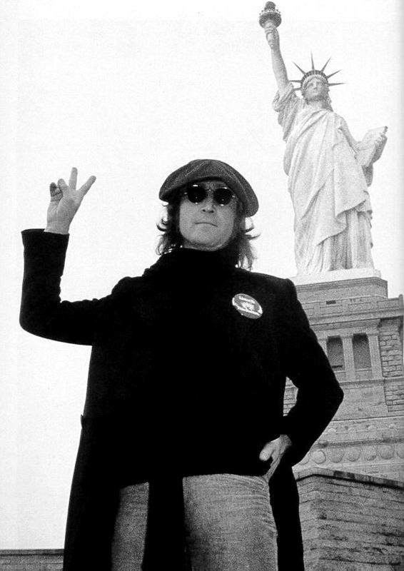
This famous photograph of John Lennon is taken from a low angle. This makes him and the Statue of Liberty both look dominating and important.

Slide 25
CONTRASTS
Contrasts make certain aspects of a picture stand out. Contrast is often to do with lighter and darker colours. For instance, in the previous photograph, the contrast between the light sky and the Statue of Liberty make the statue stand out. However, John Lennon, as the darkest element in the picture, stands out more than the statue.

Slide 26
BACKGROUND AND FOREGROUND
The focus of a picture also depends on the positioning of the objects. In the John Lennon photograph, he is in the foreground (closer to the responder). The Statue of Liberty is in the background. Objects in the foreground tend to be seen as more important.

Slide 27
TEXTURE
Texture is usually associated with touch, so it may seem strange that it is an element of visual images. However, pictures often look as though they would feel a certain way if we were to touch them, and this creates meaning.
How would you describe the texture of the following pictures?

Slide 28
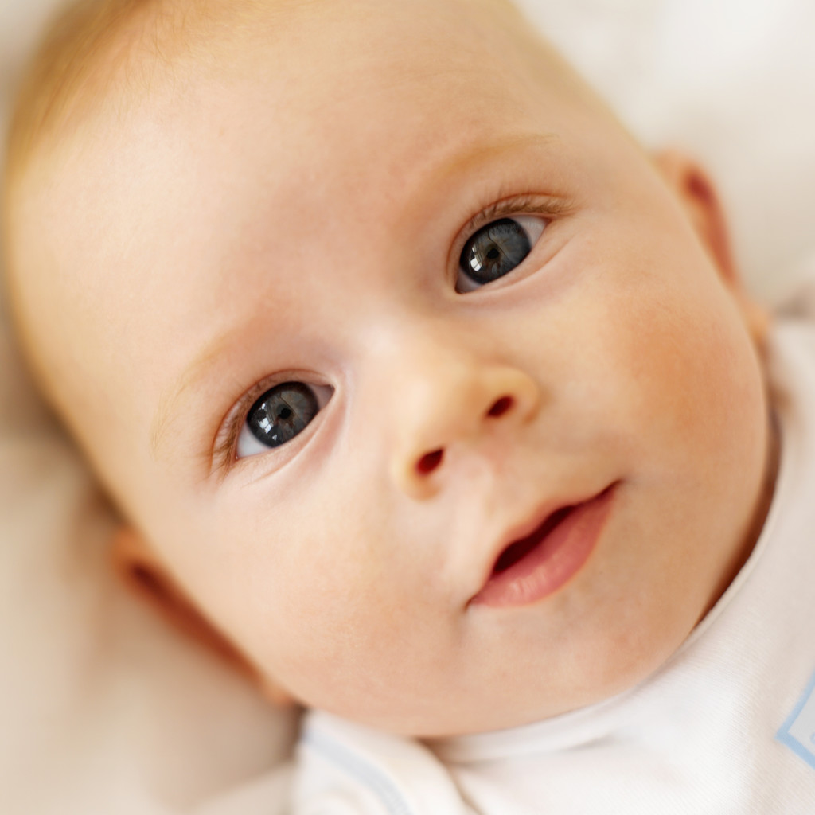

Slide 29
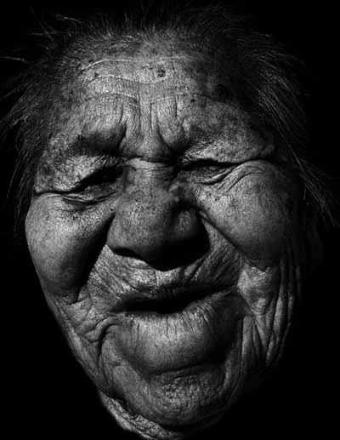

Slide 30
SALIENCE
An aspect of a text is given salience if it is given importance. There are many ways to give one aspect salience, several of which have been explored already. These include vectors, viewing angles, background and foreground and contrast. Another is simply size.

Slide 31
In the image below the words are given salience

Slide 32
In this image the image is given salience

Slide 33
OFFERS AND DEMANDS
Some objects in a picture demand that you look at them, whilst others are only offered, you do not have to look at them and you often miss them. There are many ways of creating a demand. Eye contact is one of the best.
The following painting, Pieta, by Pietro Perugino, is an example of offer and demand.

Slide 34
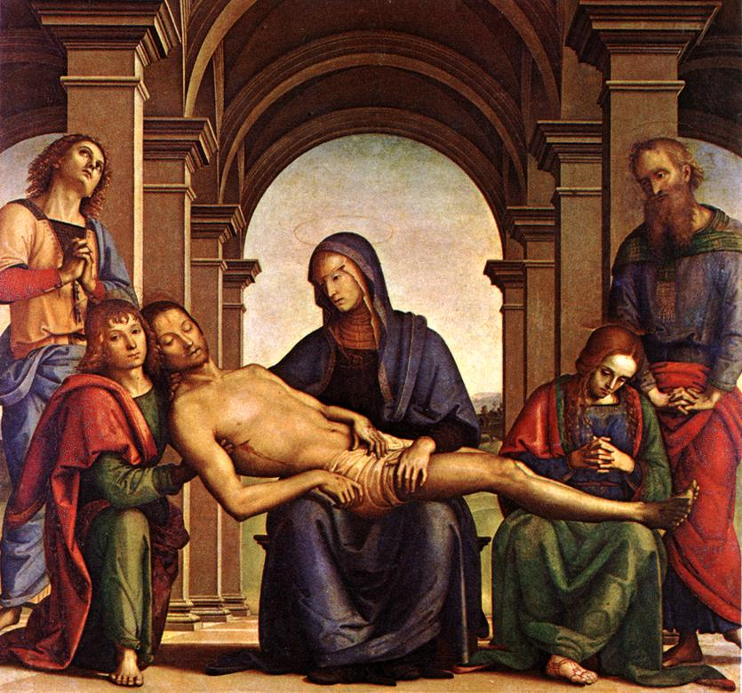

Slide 35
The painting, painted in 1494-95, is a picture of Jesus after his death and his friends around his body mourning him. There are several demands in this painting, such as the body of Christ and the Virgin Mary holding him.
However, it is not these very important figures that demand our attention, but the figure in the middle at the left. Not only does he hold the head of Christ but he looks directly out of the frame and into our eyes.

Slide 36
MODALITY
Modality refers to how realistic a picture is. If it is totally realistic it has high modality. If it contains some realism it has moderate modality. If it is non-realistic it has low modality.

Slide 37
HIGH MODALITY

Slide 38
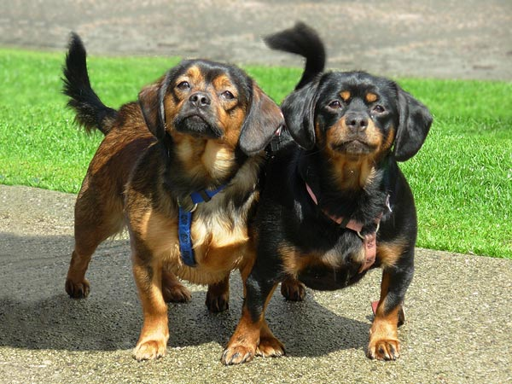

Slide 39
MEDIUM MODALITY

Slide 40
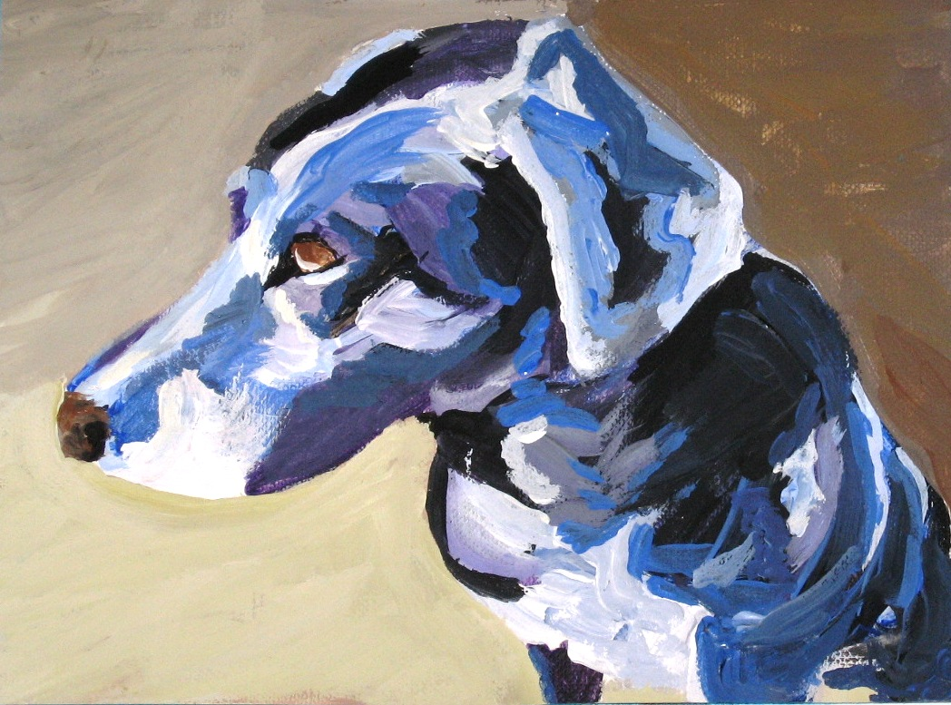

Slide 41
LOW MODALITY

Slide 42
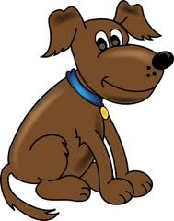

Slide 43
FRAME
Frame refers to what has been placed in the picture and where. In the painting Pieta there are six figures that are very evenly balanced; two kneeling on either side, one sitting in the centre and one laying across the central figure’s lap. The background is also very evenly framed, with the archways placed across the centre.

Slide 44
The following four slides will give you an enhanced sense of what is meant by the terms and definitions preceding this slide. They do not deal with Romeo and Juliet.

Slide 45
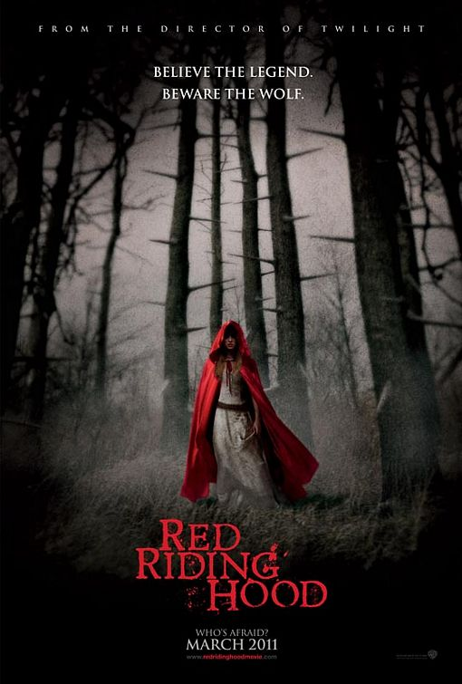
Salient image:
The saturation of black predominates the image. Consequently, the central positioning and the use of a vibrant red, draws the audience ‘s focus directly to Red Riding Hood.
Vectors:
Red Riding Hood’s gaze; her appearance of stepping forward connects with the audience. The fact that she is ‘moving’ forward from light into darkness creates a mood of apprehension.

Slide 46
Modality:
,The image of Red Riding Hood is an example of high modality, as it represents a realistic, ‘life like’ depiction of her character. This enhances the sense of foreboding within an audience as she continues her journey into an obviously hostile environment.

Slide 47
contextualised
contextualised
The background is contextualised by the vicious barbs jutting out from the densely packed trees; metaphorically representing the ravenous jaws of a wolf.

Slide 48
Colour:
is a vital element in this image. Red Riding Hood is enveloped by a blood red cape, foreshadowing the violence that is to come. Her white dress symbolises her purity and innocence. The intense saturation of black indicates the evil realm that she is walking into. It appears that she is about to be consumed by the darkness.

Slide 49
To do: Using the style of the previous four slides, choose one or more of the slides that follow to indicate how meaning is created via any of the six following visual elements.
Colour
Line
Vectors and The Reading Path
Viewing Angles and Perspective
Background and Foreground
Frame
Contrasts
Texture
Salience
Offers and Demands
Modality

Slide 50
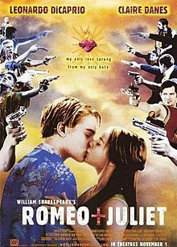

Slide 51
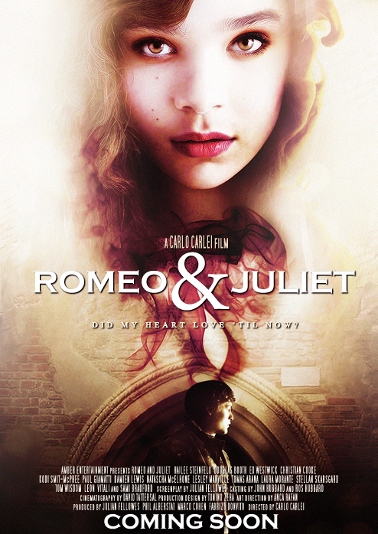

Slide 52
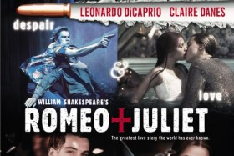

Slide 53
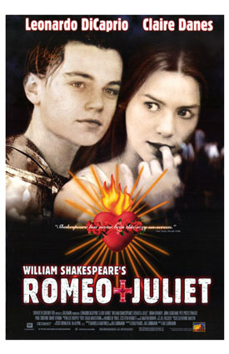

Slide 54
